Slide 1

M00674847
Aleksandrs Lukjanovs Work Presentation

Slide 2
Overview
My project is an attempt at the stock management system. Which should allow you manage the stock and staff of a small music shop. Mine is very basic but it shows potential for the future.

Slide 3
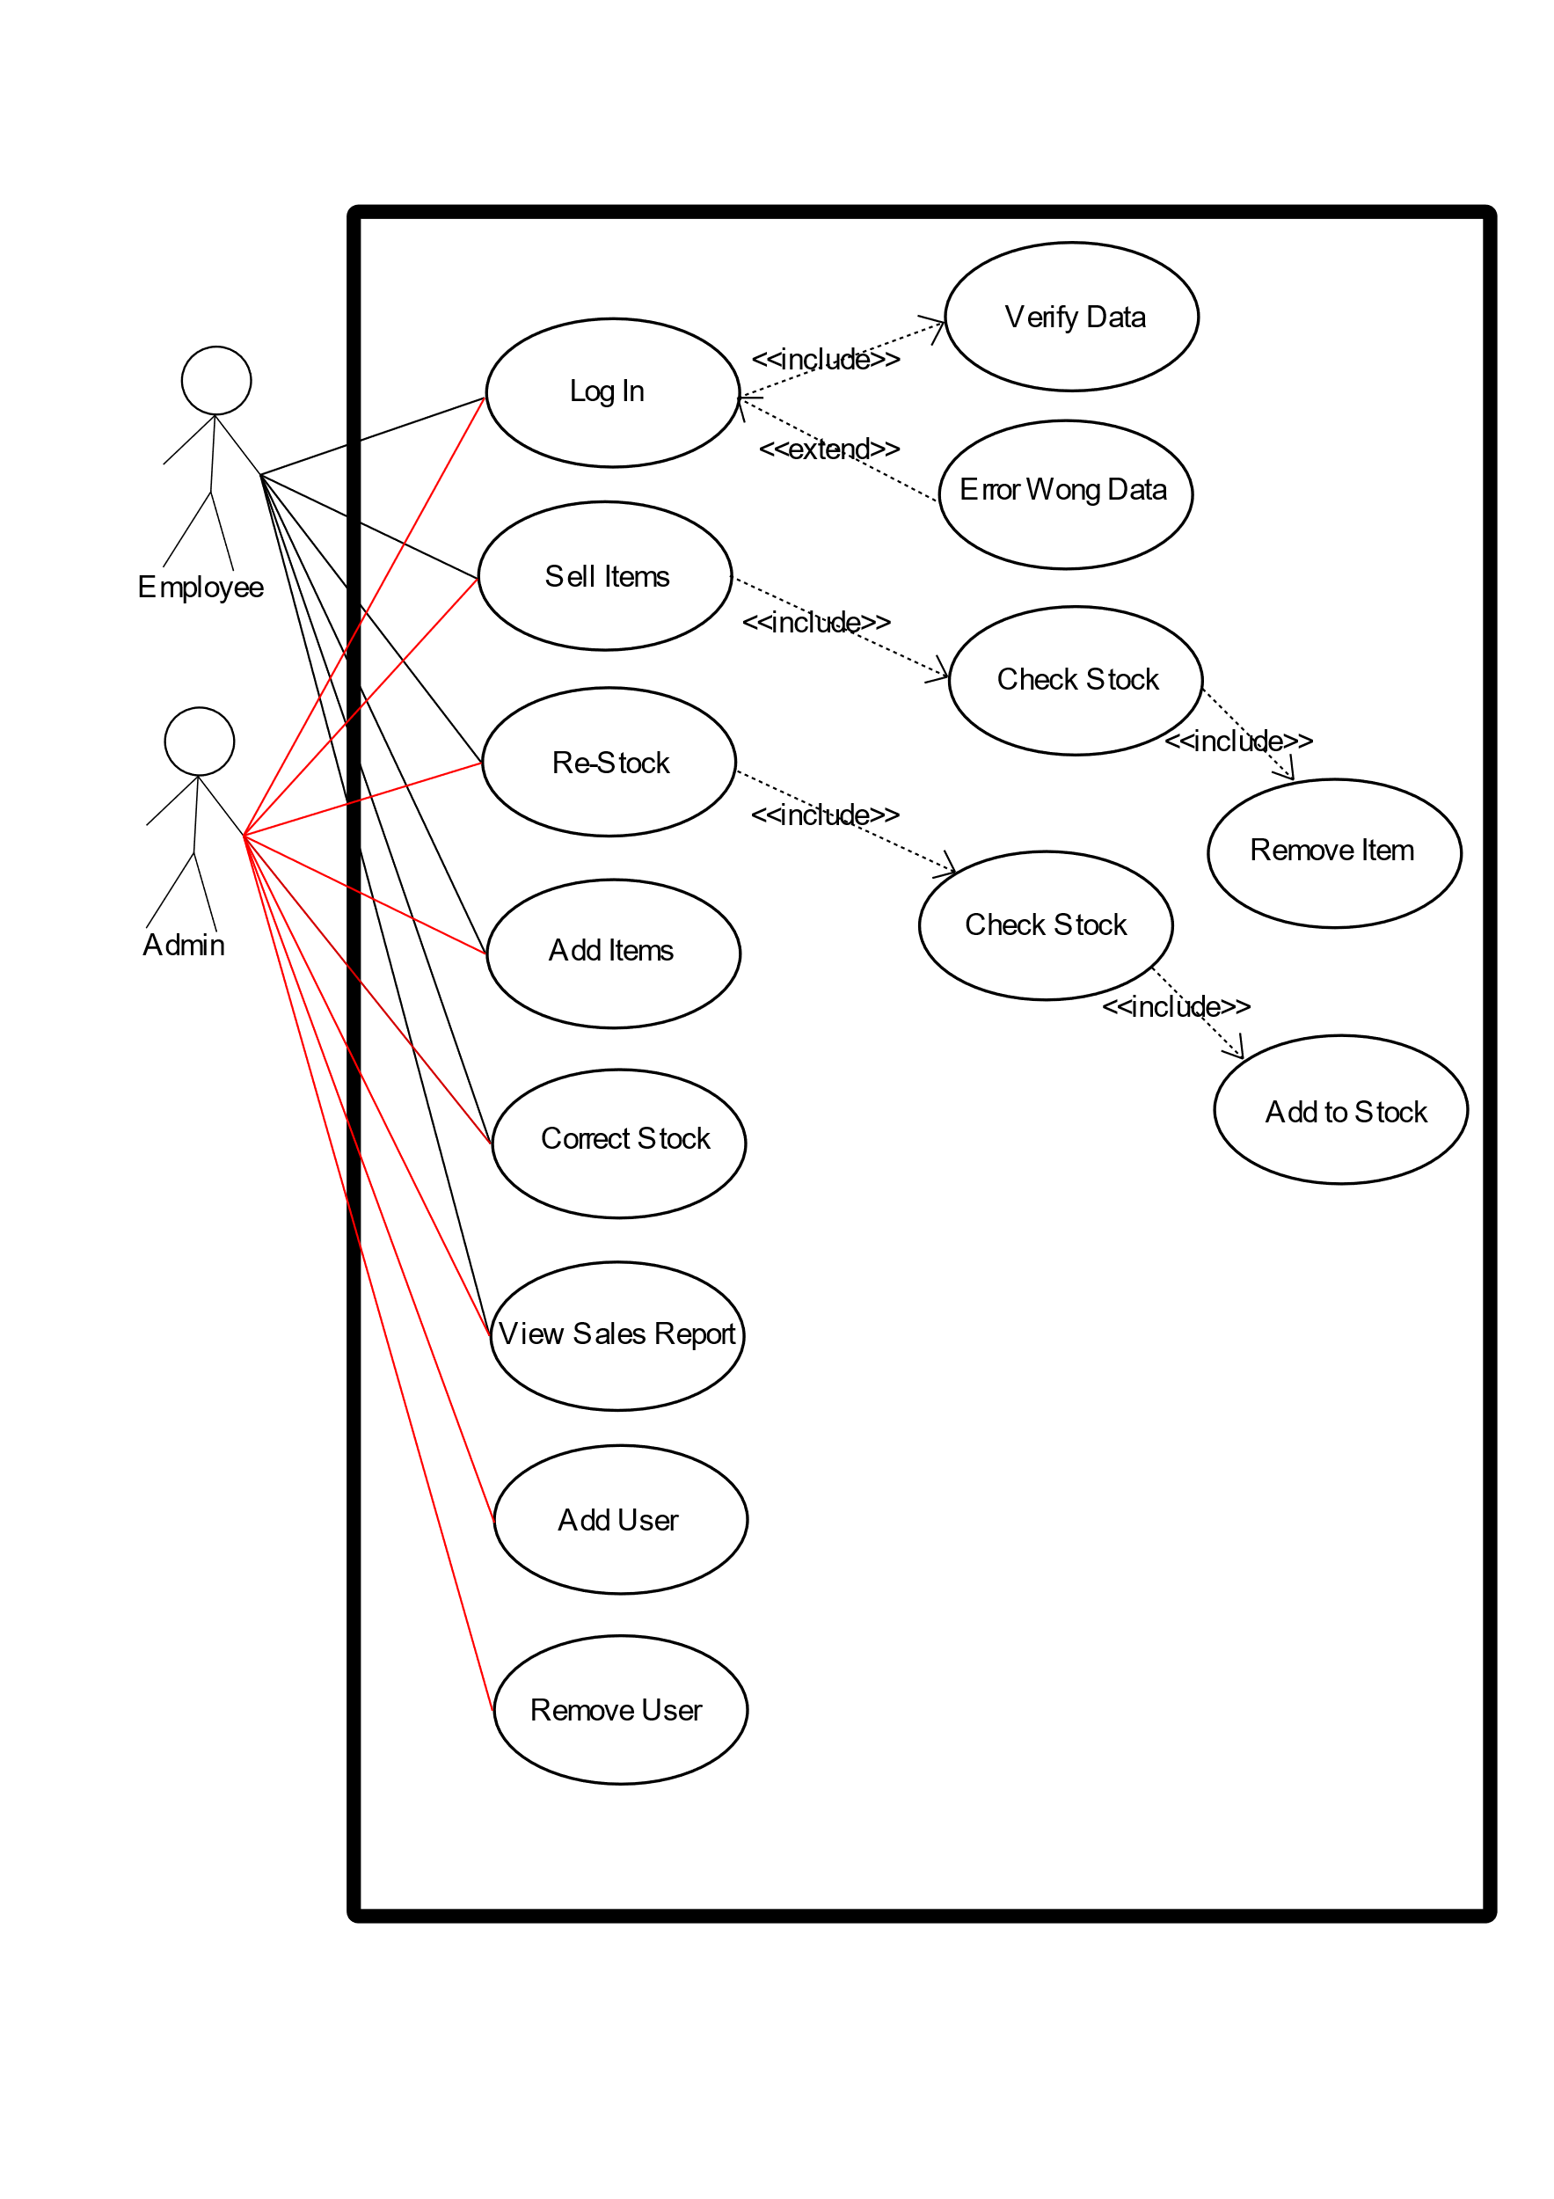
Use Case Diagram
This basic use case diagram is meant to represent what features my system should have.
From this you can see that you would have an Admin and an Employee separately Interacting but admin having more options, to remove users and add users.
Besides that there were some features such as checking stock and log in ability.

Slide 4
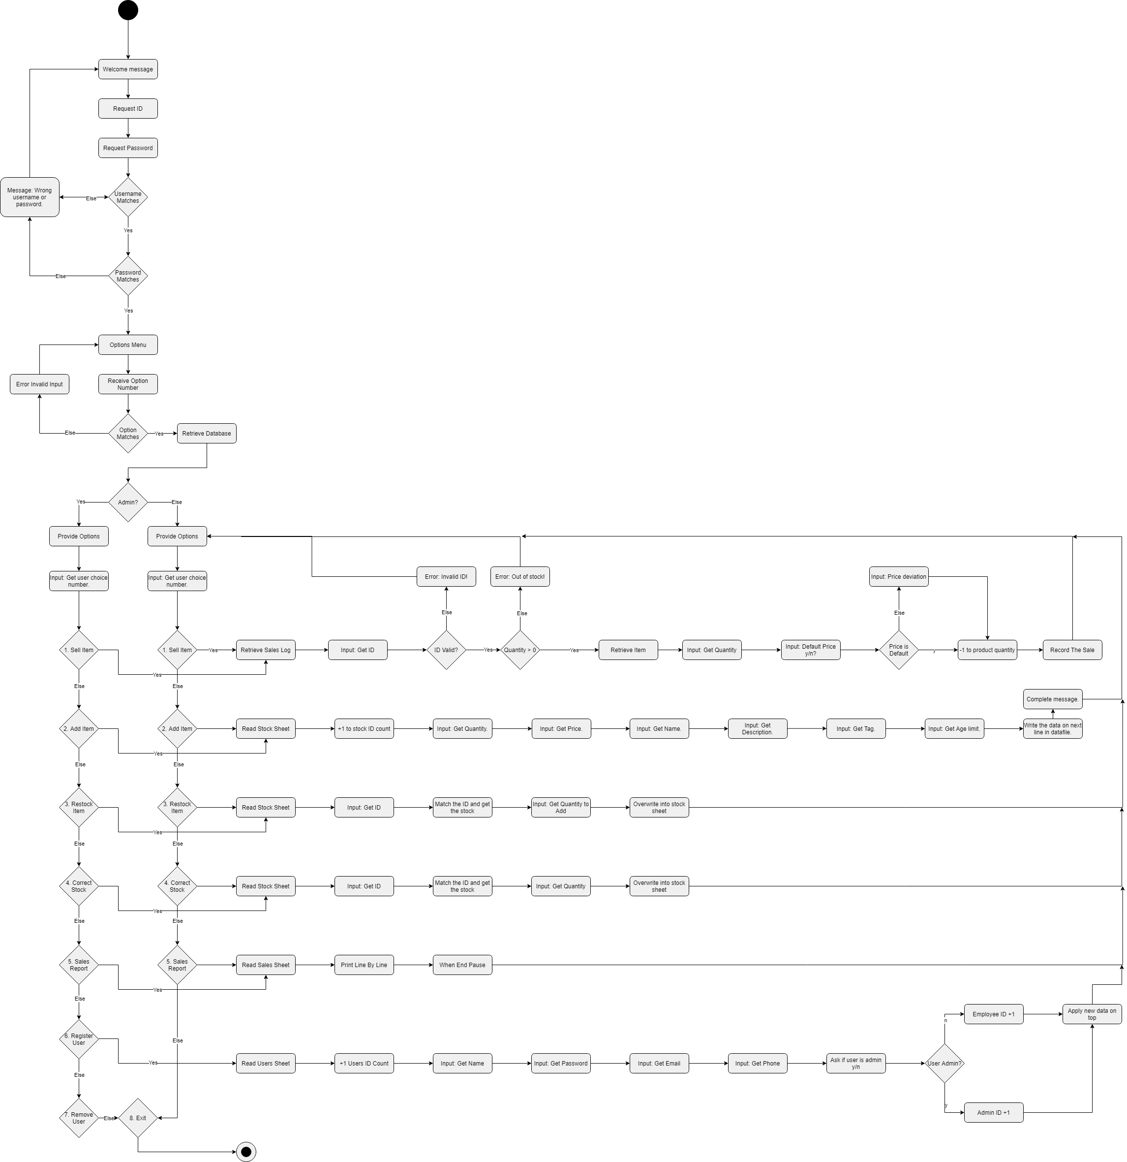
Activity Diagram
While hard to see, this diagram shows that my plans essentially are as follows:
I create a password loop to check password.
I create a loop to allow user to select input with numbers 1-8.
My branches refer to how I would go about completing the tasks that the program must be able to do such as adding products.

Slide 5
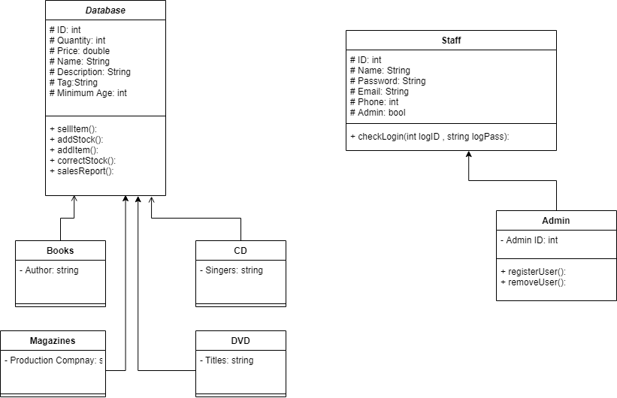
Class Diagram
This diagram shows how I planned my classes to interact and look like. Also what tasks each part would complete.

Slide 6
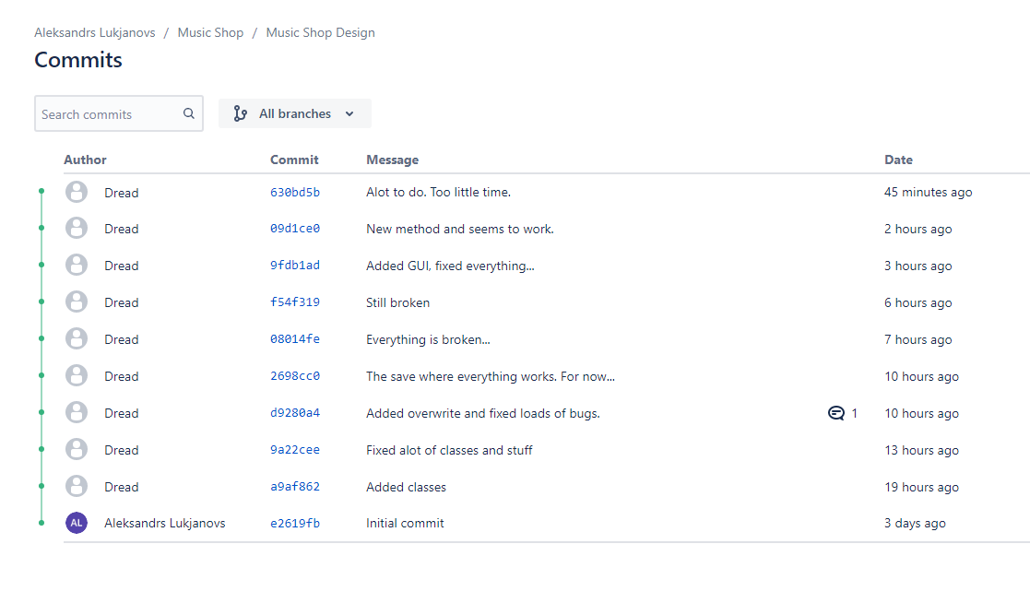
Version Control
I created my code a little by little in attempts to match my diagrams properly and to ease debugging.
Bit bucket helped me when I was stuck by showing my changes and I always knew I had a familiar version backed up in case I messed up.

Slide 7
Testing:
On this project the only testing that I did is rigorous testing inside the program using print and process of elimination. Additionally the gdb helped. So say, I found an error. I printed different parts and dismantled my code until I found the error. My method is good for segmentation core dumps.

Slide 8
In Conclusion + Progress Report
In the end I could not finish the program due to time. However the program does show that I can create classes and they are ready for future use.
I did make a basic ui with password checking.
Also my program stuck to it’s plan very well.

Slide 9
Future
If I had to do the same project again I will simply address the only factor that held me back. Time. This project was made in a week and for someone as slow as me that’s not enough. So I would have to figure out how to make up more time.

